Slide 1


ISyE 7401 Final Project: Analysis of Citation Impact using Scisci Net Database
By Moe Kyaw Thu
April 22nd, 2024

Slide 2
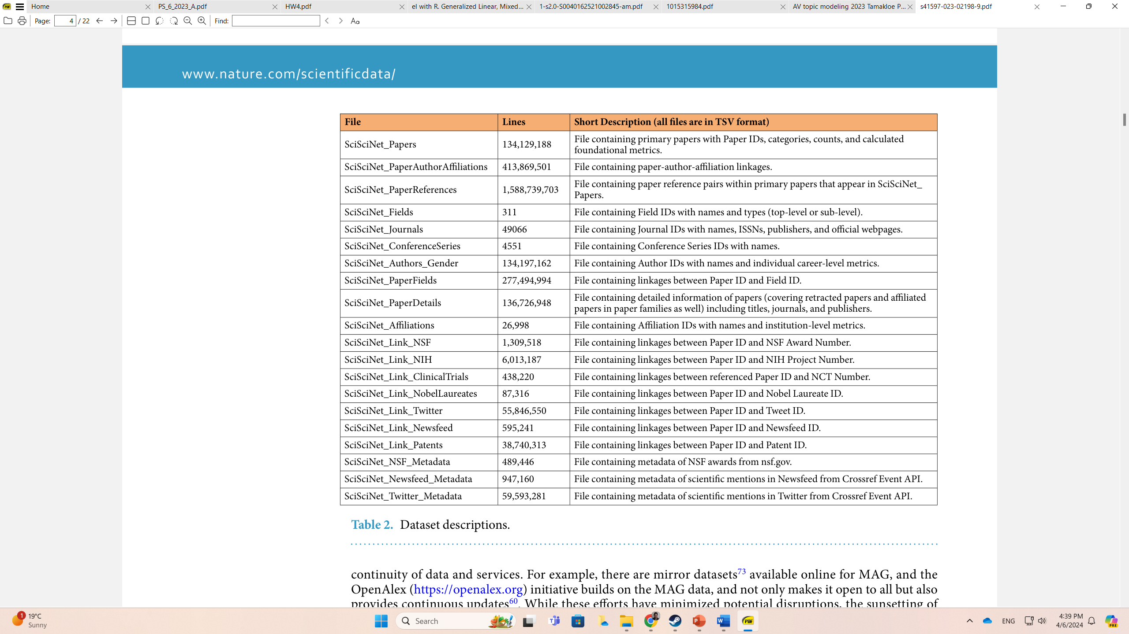
Motivation and Background
Bibliometric analysis essential in quantifying academic productivity due to the exponential growth in research publications
Existing studies emphasizes Web of Science, Scopus, Google Scholar, etc.
Focuses on Scisci Net Database (Yin 2023):
21 Datasets in total
Observations in datasets from 311 to over 1.5 billions
Integrated data from all existing data sources – WoS, Google Scholar, Microsoft Academic Graph, etc.
Purpose:
Analysis of the the citation impact using Scisci Net database with ScisciNet_Gender data set
Demonstration for future publications in Science and Technology Policy, particular Science Workforce
Fig.1. Data Sets Description

Slide 3
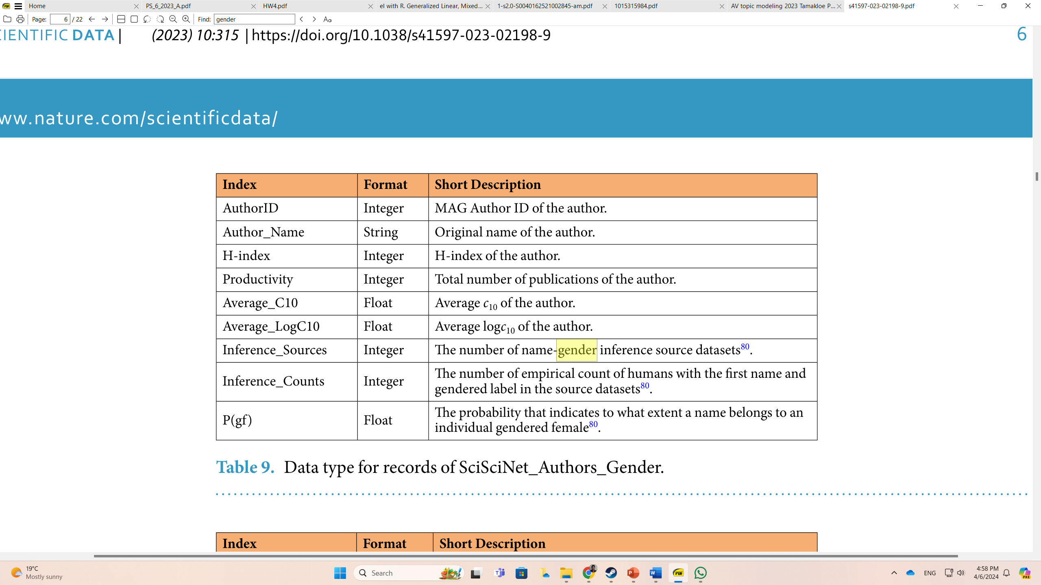
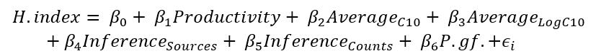
Data Sampling and Methodologies
ScisciNet_Gender data set
Observations totaling over 134 millions
9 features/columns
Data Sampling:
Chosen 5000 observations; after omitting NAs, around 4000 observations left
Left out the first two columns: AuthorID & Author_Name
H-index as Dependent Variable
Rounds up to 2 decimal places for variables Average_C10, Average_LogC10, and P.gf.
Methodologies:
Linear Regression Modeling
Model Diagnostics
Model Selection
Regularization with Ridge and Lasso Regressions
Fig.2. Codebook for Features
Fig.3. Initial Full Regression Model

Slide 4
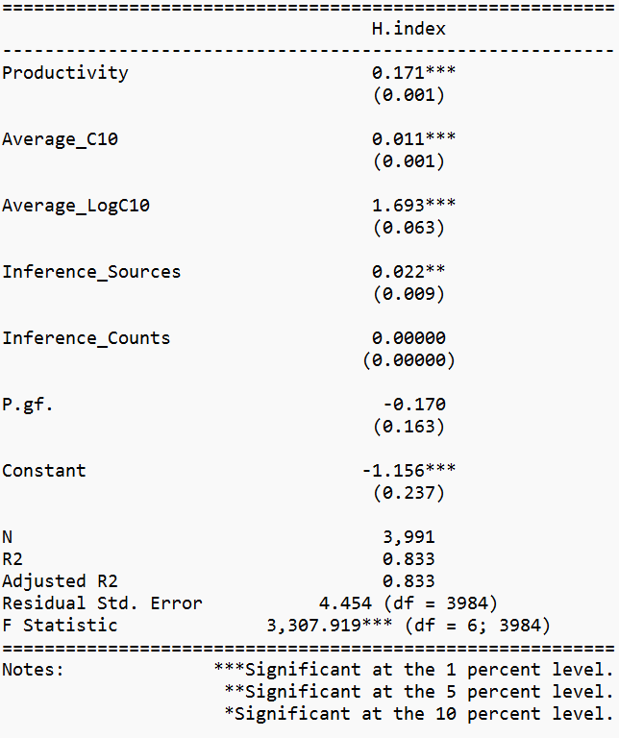
Linear Regression Modeling
Regression modeling approaches reveal statistically significant outcomes, except for P.gf. and Inference_Counts
With the use of correlation analysis, further linear regression modeling were conducted
Productivity and P.gf. as weakly correlated
Rest are moderate to strongly correlated
Linear regression with Productivity and P.gf. combined show the latter having no statistical significance; but tested with individual models, both are significant albeit with low R-squared values
Quadratic testing shows everything significant except Average_C10 and Inference_Counts
Interaction terms similarly show ONLY Inference_Counts as not having any significant, but rest shows significance
Fig.3. Full Regression Model Output using Stargazer Package

Slide 5
Model Diagnostics
Multicollinearity testing using Variance Inflation Factor (VIF) indicates generally low to moderate multicollinearity among predictor variables in the original model.
Normality testing for residuals with the Breusch-Pagan test shows heteroskedasticity, indicating unequal variance of errors.
Assessment of leverage points identifies ONLY one observation at 3845, suggesting its significant impact on the model due to its large leverage.
Cook’s distance analysis also identifies observation 3845 as the most influential point, indicating its considerable influence on model fit and assumptions.
Outlier detection reveals observation 3441 as the only outlier

Slide 6
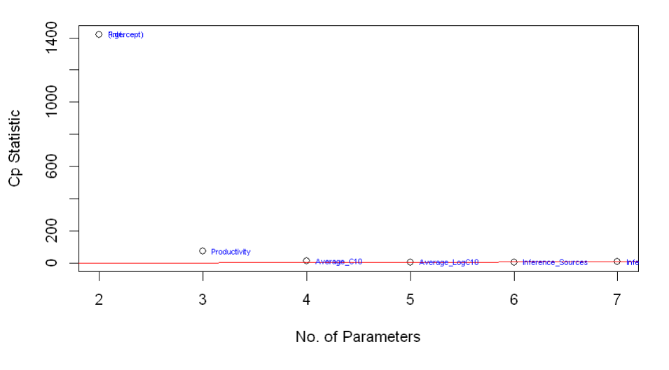
Model Selection
Subset regression analysis using adjusted R-squared identifies a model with 5 variables explaining 83.25929% of variance, with marginal improvement upon adding a sixth variable.
Similarly, Cp criteria shows between 4 and 5 parameters.
HOWEVER, stepwise Regression shows optimal model with 4 parameters that comprise Productivity, Average_C10, Average_LogC10, and Inference_Sources, AIC value of 11927.72.
But compared to the full model, the difference is only 0.03, so very marginal improvement, and effective model reduction while maintaining fit
Fig.4. Plotting for Cp Criteria

Slide 7
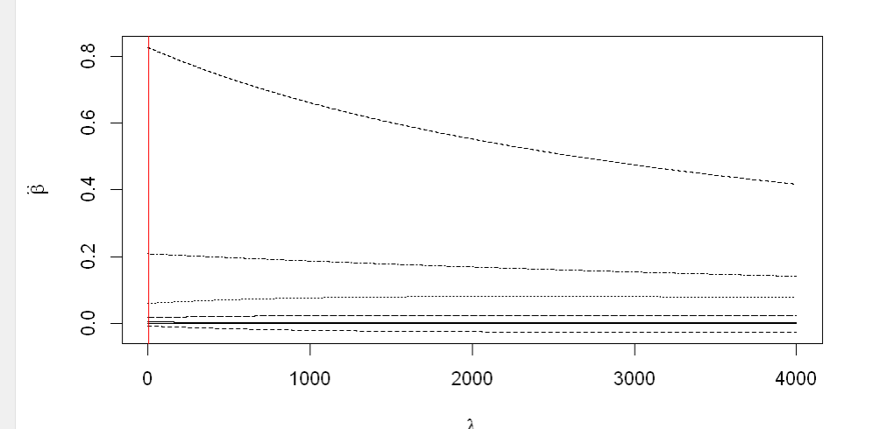
Regularization: Ridge Regression
All predictor variables included in the model with a sequence of lambda values ranging from 0 to 4000 specified for regularization
Optimal lambada here is 1.8, meaning model fit the data more closely.
H.index potential values likely to be centered, and coefficients indicate positive associations for variables Productivity, Average_C10, Average_LogC10, Inference_Sources, and Inference_Counts, while P.gf. as no significant association.
Nonnegative garrote shows Inference_Counts and P.gf., the rest of the variables have a zero impact on H.index, albeit with relatively small negative coefficients
Fig.5. Plotting for Ridge Regression using GCV

Slide 8
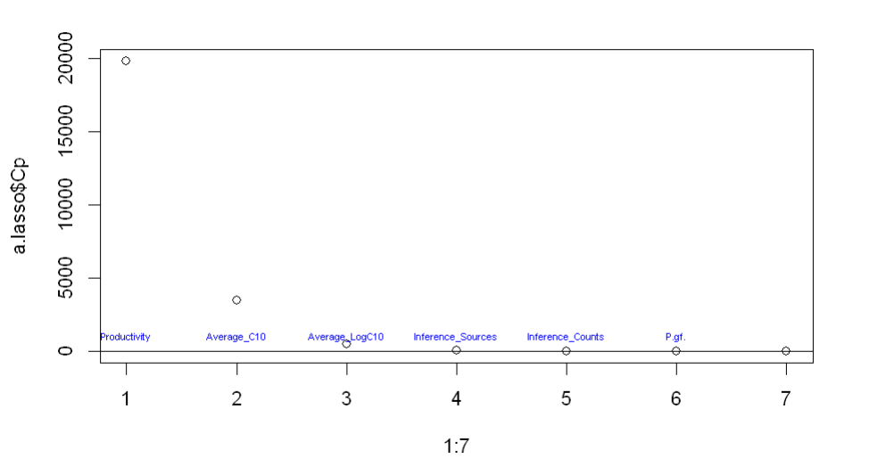
Regularization: Lasso Regression
Parameters 3 to 7 are identified as the best fit, indicating that inclusion of variables other than Productivity demonstrates a good fit.
Leave-one-out cross-validation yields an optimal lambda of 0.003309913, suggesting a close fit of the model to the data with less regularization.
Fig.6. Plotting for Lasso Regression

Slide 9
Conclusion
Notably, there is a negative association between H.index and P.gf., indicating that researchers likely to be female tend to have lower H.index
Productivity consistently shows positive association with H.index, suggesting that higher academic output leads to a higher H.index.
Average_C10, Average_LogC10, and Inference_Sources play significant roles in predicting H.index.
Regularization techniques applied to all predictor variables yield varying degrees of success in predicting H.index, with potential challenges of overfitting, particularly ridge regression.
Suggestions for future research include exploring alternative methods for gender inference to enhance accuracy and reliability, such as incorporating natural language processing techniques.

Slide 10
Reference
Yin, Yian (2023). SciSciNet: A large-scale open data lake for the science of science research. figshare. Collection. https://doi.org/10.6084/m9.figshare.c.6076908.v1

